Slide 1
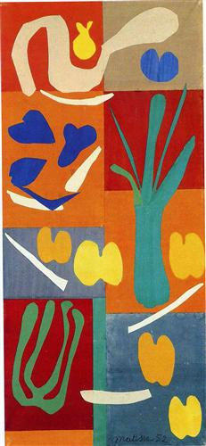
“Fall”owing Henri Matisse and His Cut-outs
“Vegetables”. 1951. Gouache on paper, cut and pasted.
68 7/8” x 31 7/8”.

Slide 2
Definitions of Cut-outs & Collaging
Cut-outs: Cutting the paper into various shapes.
Collaging: Gluing the shapes or cut paper onto another paper (can be a board, a wall, etc.)

Slide 3
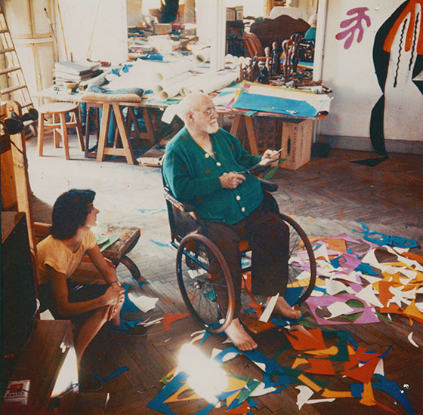
Matisse’s Process
Matisse used different sized scissors to cut out his shapes freehanded.
He kept both the shape he cut out and the paper he cut from.
Sometimes to get the color he wanted, he would paint the entire paper first before cutting it.
Matisse would then pin his cut-outs to the wall or board

Slide 4
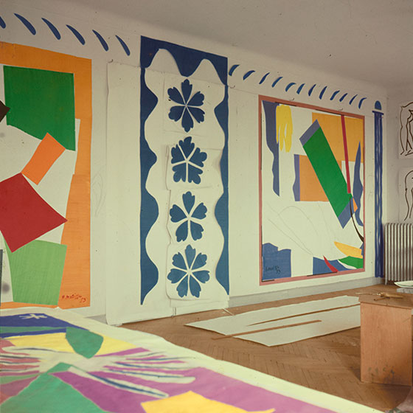
Types of Shapes
Organic:
shapes found in nature
2) Inorganic (Geometric):
shapes not like to be found in nature.
Have a precise measurement

Slide 5
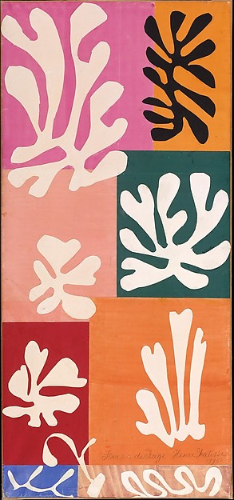
“Snow Flowers”. 1951. Watercolor and gouache on cut and pasted papers. 68.5” x 31.75”

Slide 6
Our Project
We are going to create our own collage based on the season Fall.
What are some objects you see during the fall time?

