Slide 1
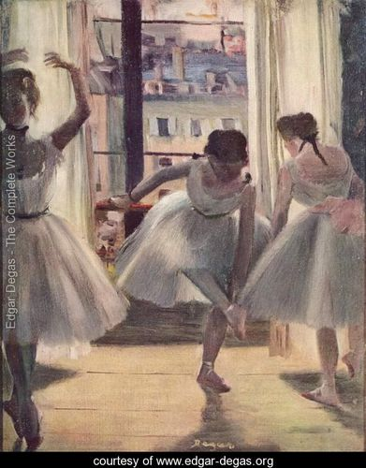
Figurative Drawing
Posture and Emotion

Slide 2
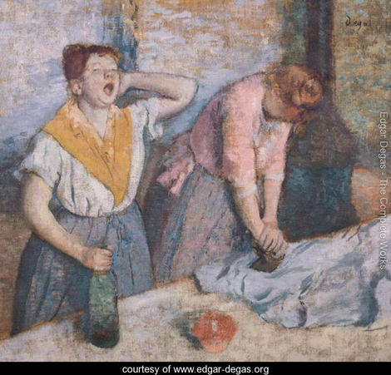
Based on the women’s postures, what kinds of emotions are they feeling?

Slide 3
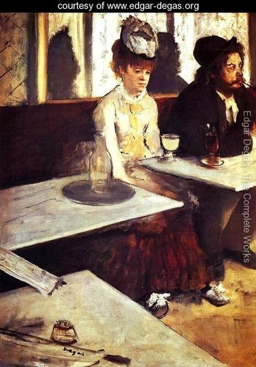
What emotion do you see here?

Slide 4
