Slide 1
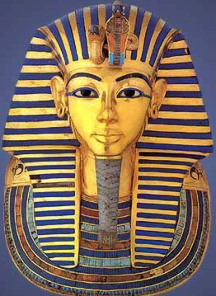
Funerary and Ritual Masks of Ancient Egypt

Slide 2
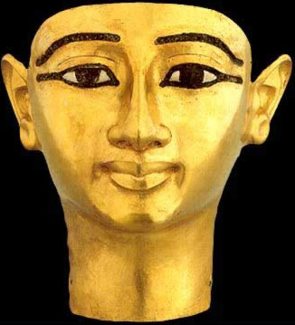
Whether worn by the living or the dead, masks played a role of magically transforming an individual from a mortal to a divine state.

Slide 3
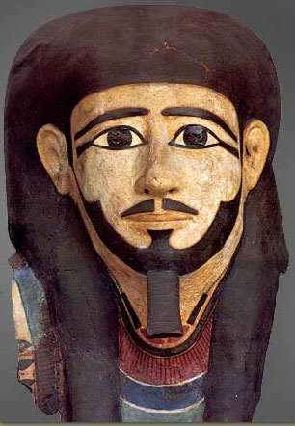
*The very earliest masks were experimentally crafted as independent sculptural work
*These early masks were made of wood
*Hollow and solid masks were also built by pouring clay or plaster into generic, often unisex molds

Slide 4
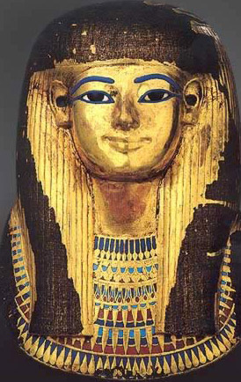
Masks became increasingly more sophisticated during the New Kingdom. These later masks made for royalty were beaten from precious metals. Of course, an obvious example of such is the solid gold mask of Tutankhamun, though we also have fine gold and silver specimens from Tanis.

Slide 5
*Masks of all types were embellished with paint, using red for the flesh tones of males and yellow, pale tones for females.
*Eyes or eyebrows were inlaid, as well as other details that could elevate the cost of the finished product considerably.
*Indications of social status, including hairstyles, jewelry, costumes and of course headdresses.

Slide 6
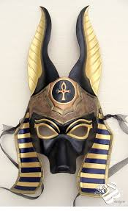
Ritual masks were worn by priests during rituals.
They were made to represent animal heads, heads of gods of ancient Egypt.

Slide 7
CREATE YOUR
OWN!

