Slide 1
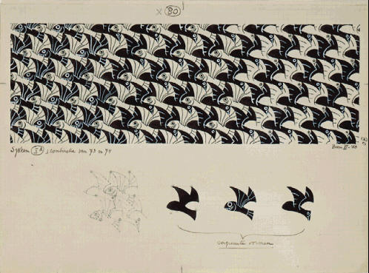
Tessellation and MC Escher

Slide 2
What is a tessellation?
“Any pattern made of repeating shapes that covers a surface completely without overlapping or leaving any gaps.”
Can you name a few examples?
www.exploratorium.edu/geometryplayground/Activities/GP_Activities_6-8/ExploringTessellations_%206-8_v4.pdf.

Slide 3
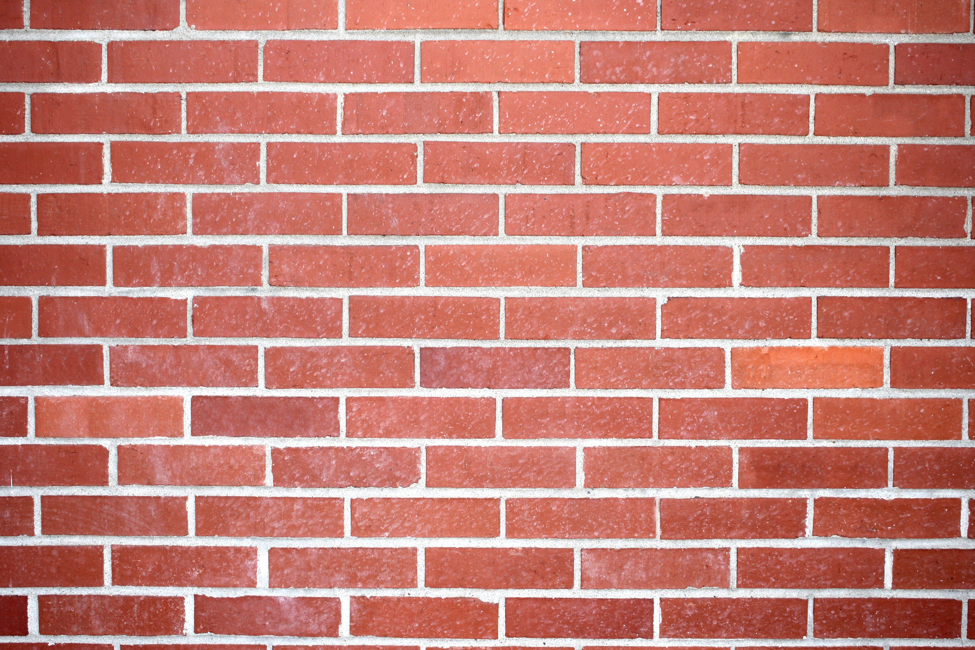
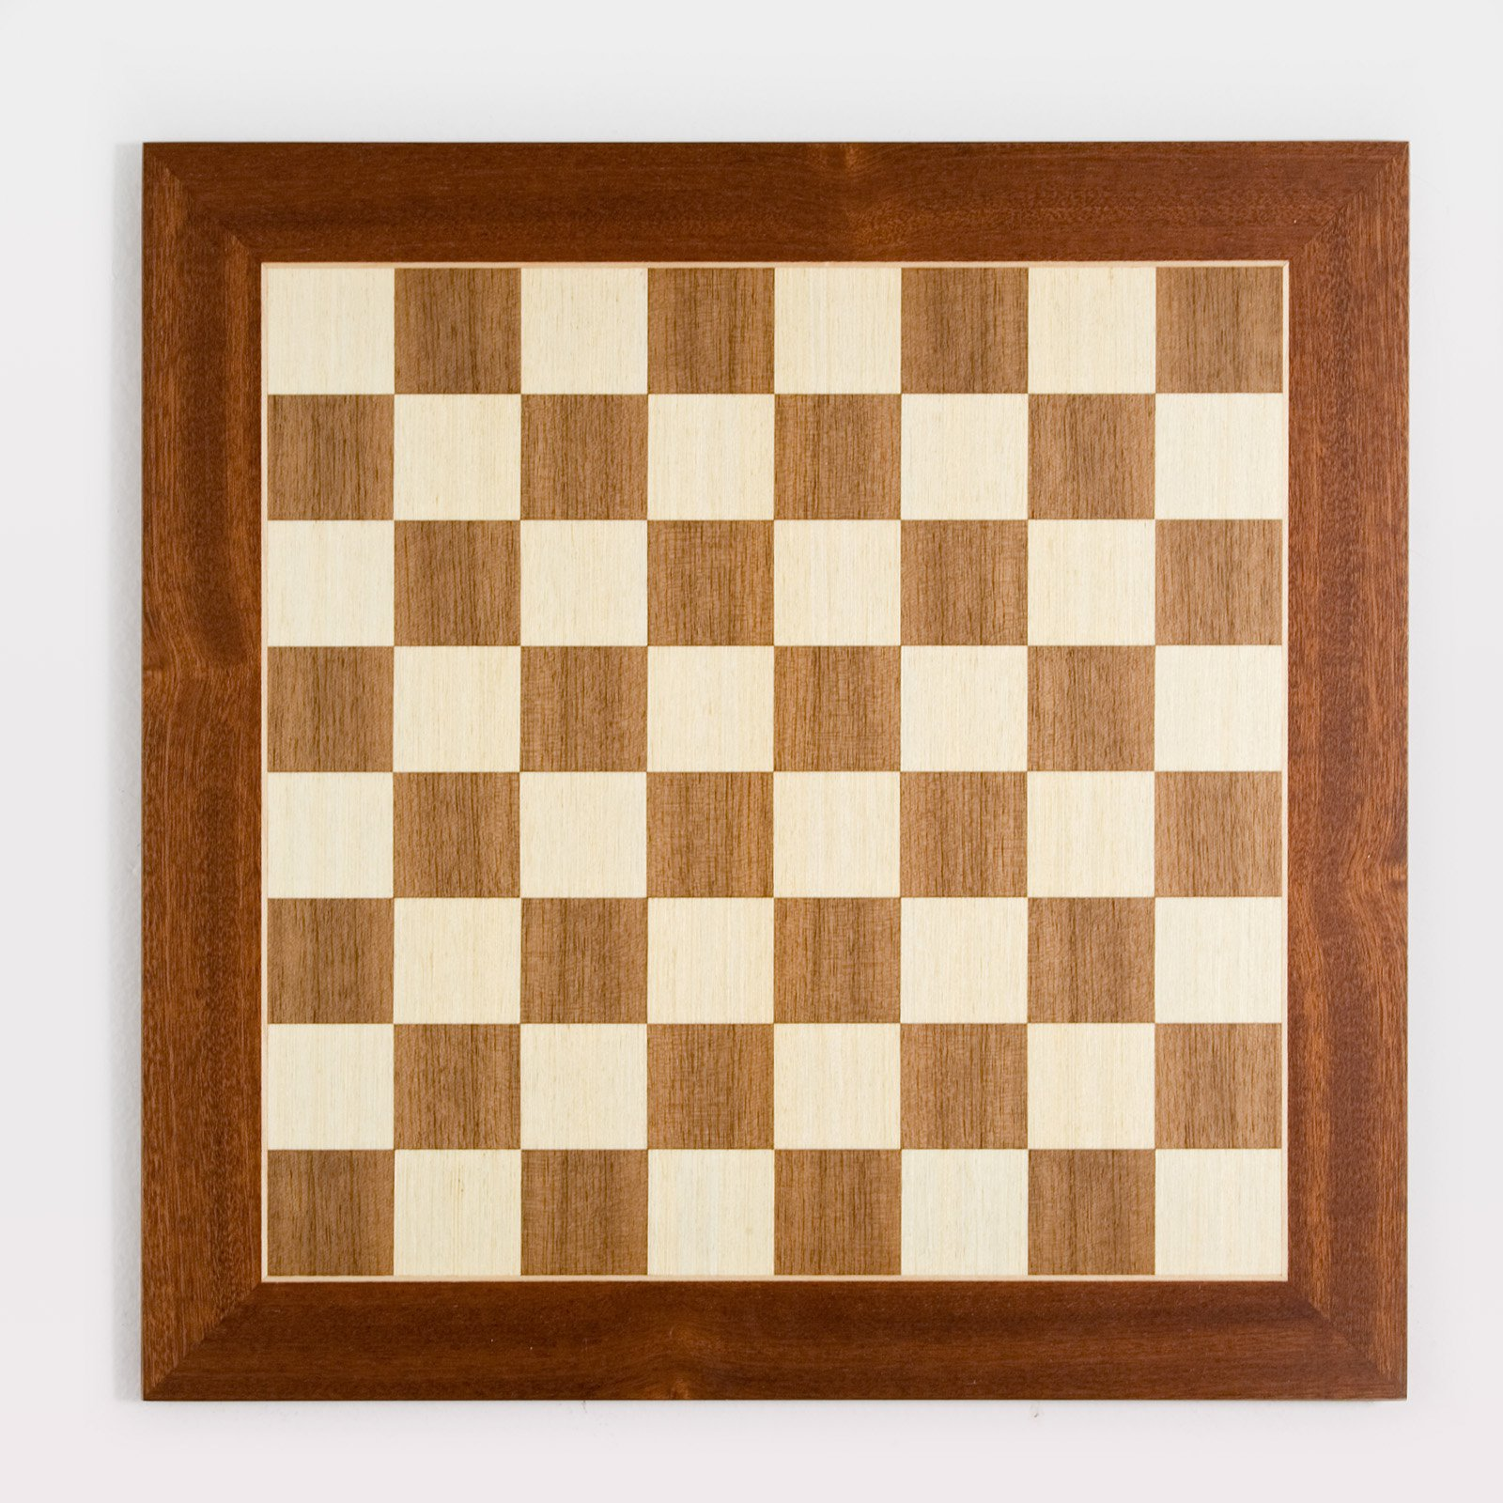
What is a tessellation?
“Any pattern made of repeating shapes that covers a surface completely without overlapping or leaving any gaps.”
A brick wall
A chess board

Slide 4
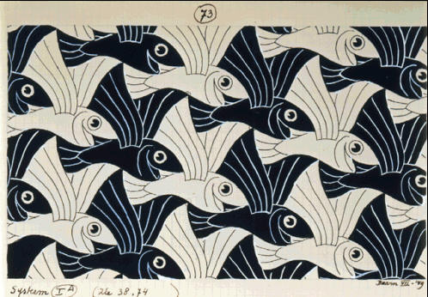
“Flying Fish (No. 73)” 1949. Ink, watercolor.

Slide 5
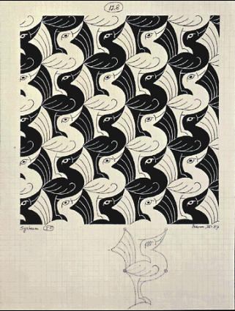
“Bird (No. 128)” 1967. Ink, watercolor.

Slide 6
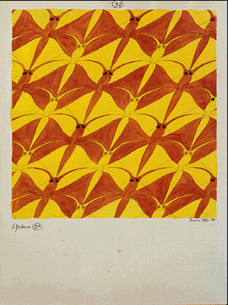
“Dragonfly (No. 38)” 1941. Pencil, ink, watercolor.

Slide 7
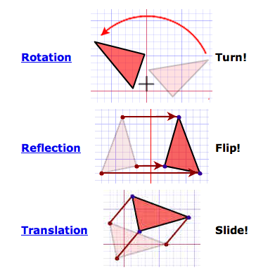
Mathematical Transformations

Slide 8
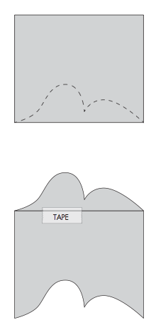
How to Create a Simple Tessellation
1
First, use a 2.5” x 3” rectangular paper and make a design at the bottom.
Then, cut it out.
Second, slide that cut-out piece to the top part of the rectangular paper.
Make sure the edges are not overlapping or have a gap. Put tape on the two pieces.
2

Slide 9
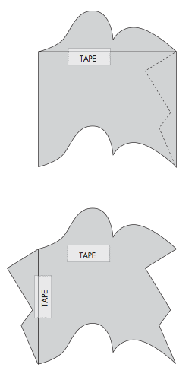
How to Create a Simple Tessellation
3
Third, make a design on the right side.
Cut it out.
Fourth, slide the second piece to the left side.
Make sure the edges are not overlapping or have a gap. Put a piece of tape on both pieces.
4

Slide 10
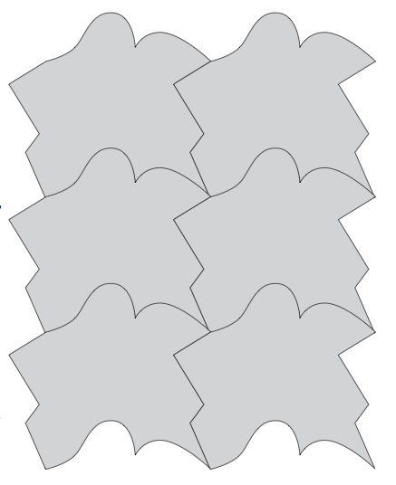
How to Create a Simple Tessellation
5
Once you have your tessellation piece, trace it onto your paper by putting it first in the middle of your paper.
Then, slide (translate) that piece upwards so the bottom fits the top part of the drawing you just made.
Trace the tessellation piece again.
Keep fitting the tessellation piece with itself until the whole page is full!

